Slide 1



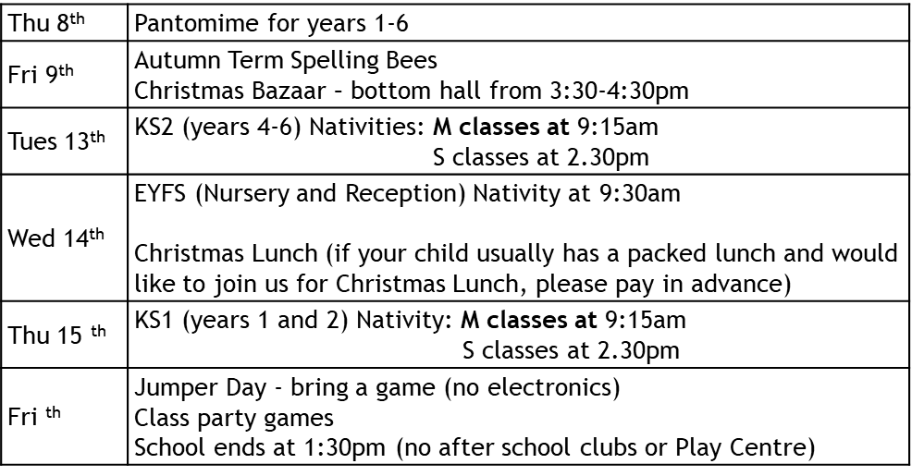

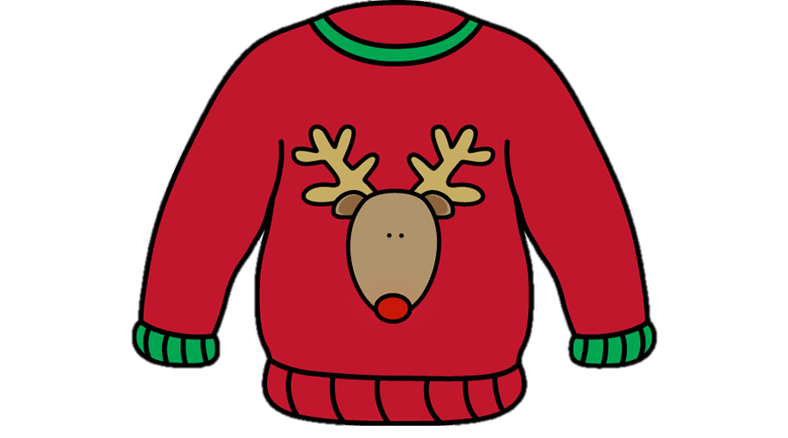
Morningside Primary School December Overview 2022
Morningside Primary School December Overview 2022
Thu 8th | Pantomime for years 1-6
Fri 9th | Autumn Term Spelling Bees Christmas Bazaar – bottom hall from 3:30-4:30pm
Tues 13th | KS2 (years 4-6) Nativities: M classes at 9:15am S classes at 2.30pm
Wed 14th | EYFS (Nursery and Reception) Nativity at 9:30am Christmas Lunch (if your child usually has a packed lunch and would like to join us for Christmas Lunch, please pay in advance)
Thu 15 ^{th} | KS1 (years 1 and 2) Nativity: M classes at 9:15am S classes at 2.30pm
Fri ^{th} | Jumper Day - bring a game (no electronics) Class party games School ends at 1:30pm (no after school clubs or Play Centre)

